Slide 1


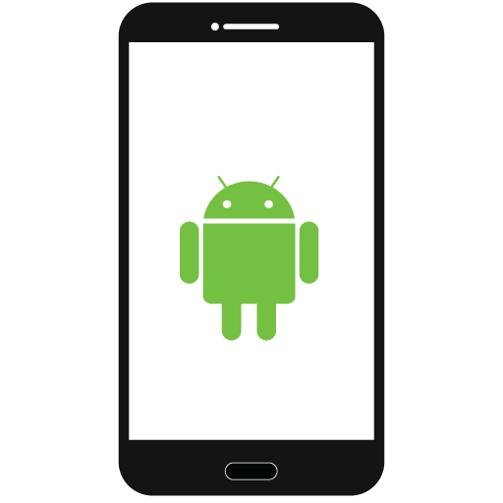
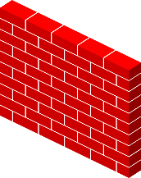


2.1 High level component and their interactions
Server
Client
Firewall
Firewall
Network
Mobile Interface
Database Server
Travlendar+ DB
Application Logic
/-Da cambiare-/
*
*
The 2-tier architecture develops in the best way our project ideas: all logical operation regarding to app functionalities
are computed in the client part, instead the data are securely preserved in databases, accessible through the database
server.
The logic application needs this data to work properly, so it requests them from the database server in which there all
database which contain the data needed.
Between client and server we provide more security through a firewall

Slide 2
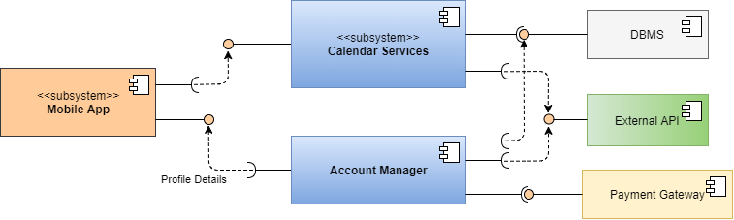
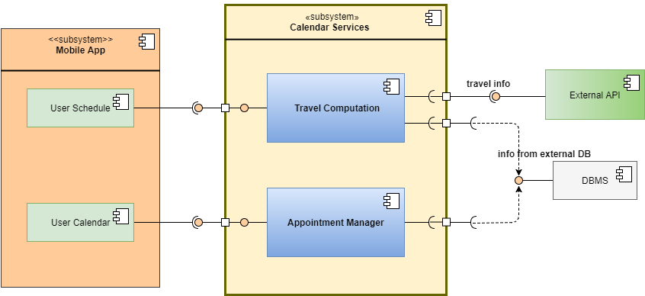
2.2 Component view
Interaction among architectural component
is so defined:
The subsystem ‘Calendare Services’ requires
the interface from DBMS, which provides
information stored inside travlendar+ database
or external database, and the interface of external API,
which provides travel information to compute
Best travel for user. Instead it provides
interface for the user app.
The ‘Payment Manager’ require the interface of
A payment gateway, which permits to execute
Payments, and requires the interface of
user account to take information
About account details

Slide 3

2.2 Deployment view
<<device>>
Mobile Smartphone
<<device>>
Database Server
Mobile Interface
<<device>>
Firewall
Oracle MySQL Database
Application
Logic
JDBC
JDBC
External Database

Slide 4



2.6 Architectural styles and patterns
Architectural style:
3-tier Client-Server
Data
Client
Server
Database
Server
Dbms
Mobile Interface
Network
Application
Server
Travlendar+ DB
Travlendar+ provides an client-server structure…***da cambiare( in which logic application takes place in the client part, because the
application contains functionalities which doesn’t depend on internet service, so we consider usefull that the user can use
this functionalities without connecting to the server. For the rest of functionalities, network, and so internet service, is
fundamental to guarantee the complete use of Travlendar+. To do this, the app requires data from DBMS through the
database server and this one is connected to the client through the network)

Slide 5
2.6 Architectural styles and patterns
Patterns:
State pattern
Visitor pattern

